Slide 1
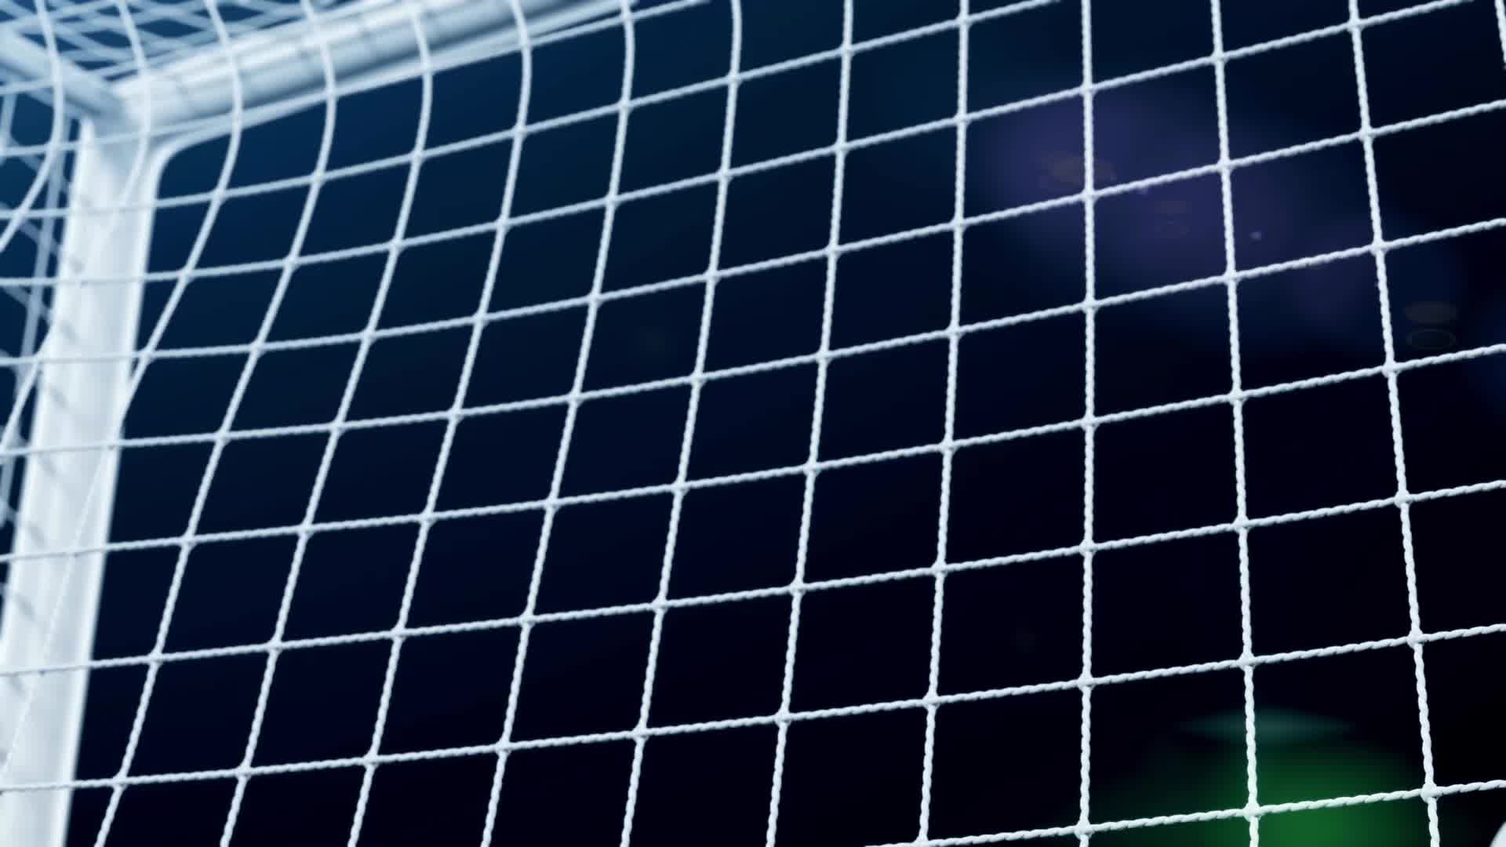
Assignment A07: Applying Filters to an Image Grid
By: Jesus Gudino
03/07/2025
Professor: Anna Devarakonda

Slide 2
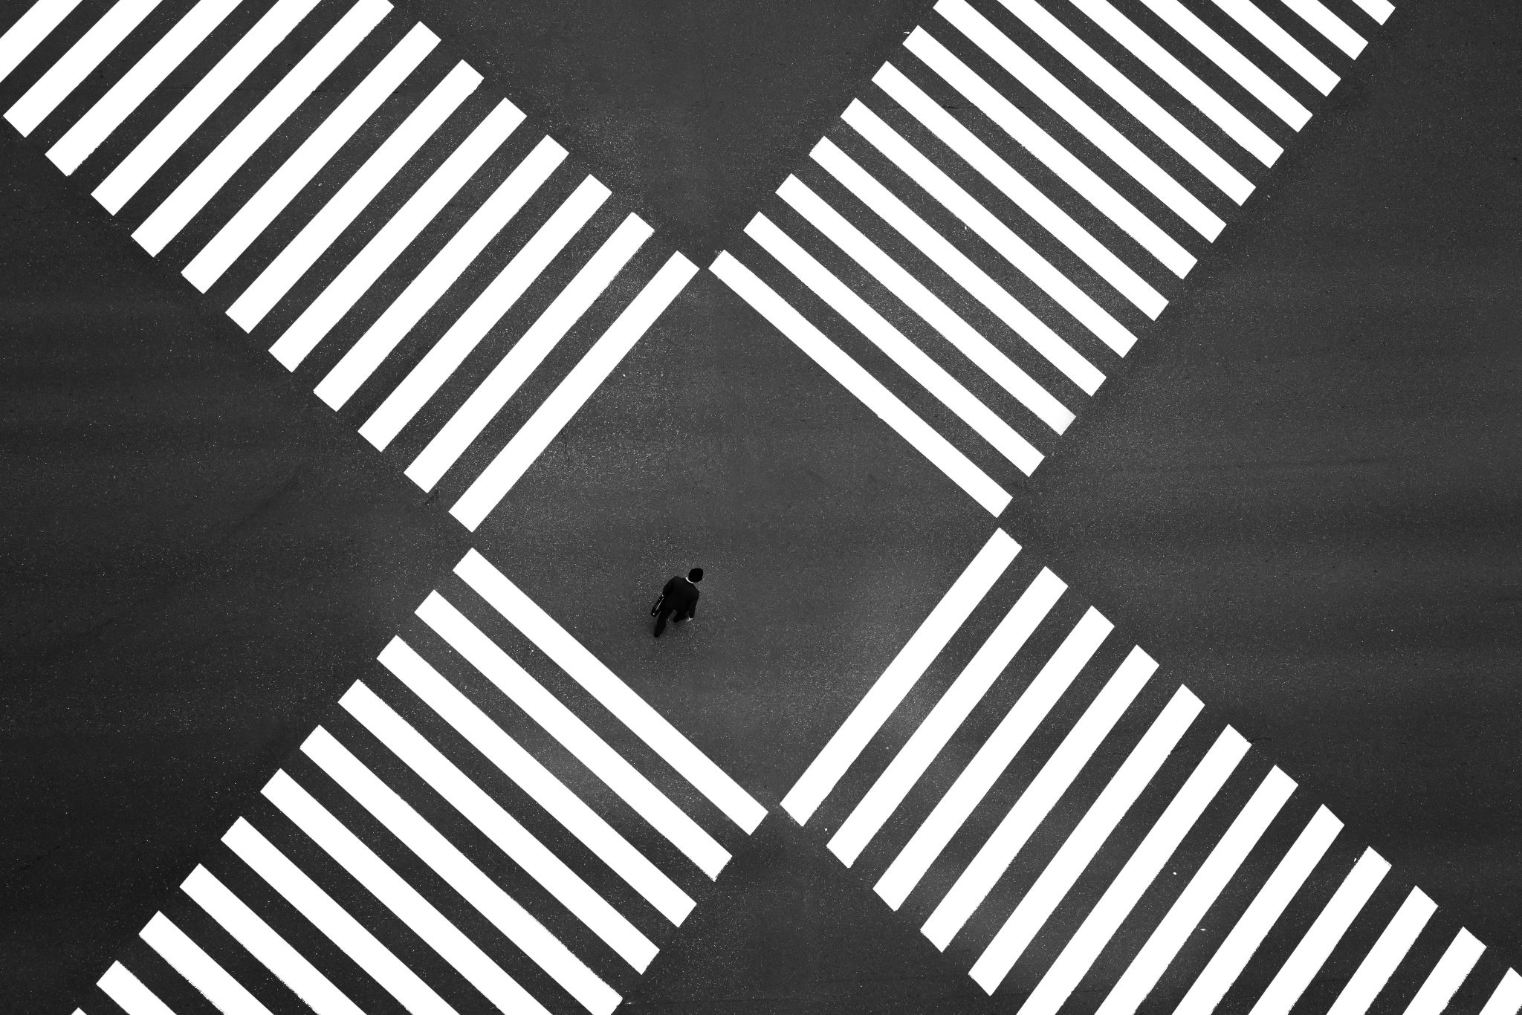
Grid Representation
0 | 0 | 0 | 1 | 1 | 0 | 0 | 0
0 | 0 | 0 | 1 | 1 | 0 | 0 | 0
0 | 0 | 0 | 1 | 1 | 0 | 0 | 0
1 | 1 | 1 | 1 | 1 | 1 | 1 | 1
1 | 1 | 1 | 1 | 1 | 1 | 1 | 1
0 | 0 | 0 | 1 | 1 | 0 | 0 | 0
0 | 0 | 0 | 1 | 1 | 0 | 0 | 0
0 | 0 | 0 | 1 | 1 | 0 | 0 | 0
This represents a white cross (1s) on a black background (0s).

Slide 3

Designing Filters for Feature Detection
Vertical Edge Detection Filter
Horizontal Edge Detection Filter
SHARPENING
FILTER
-1 0 1
-1 0 1
-1 0 1
- Detects vertical edges (left-to-right contrast)
-1 -1 -1
0 0 0
1 1 1
- Detects horizontal edges (top-to-bottom contrast)
0 -1 0
-1 5 -1
0 -1 0
- Enhances image details and contrast

Slide 4
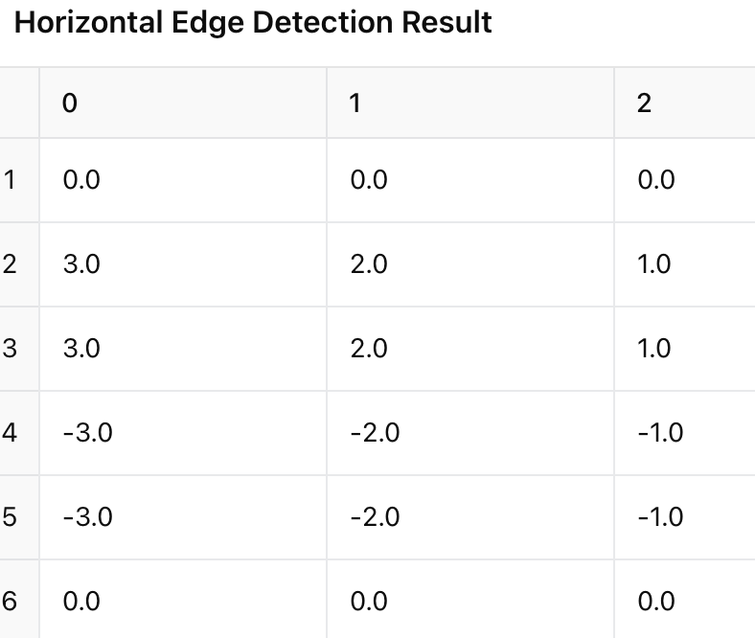
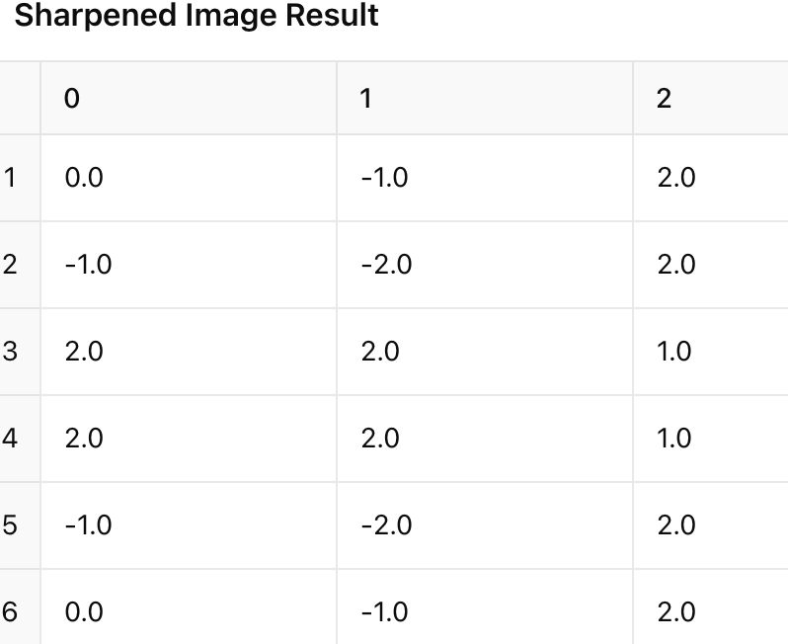
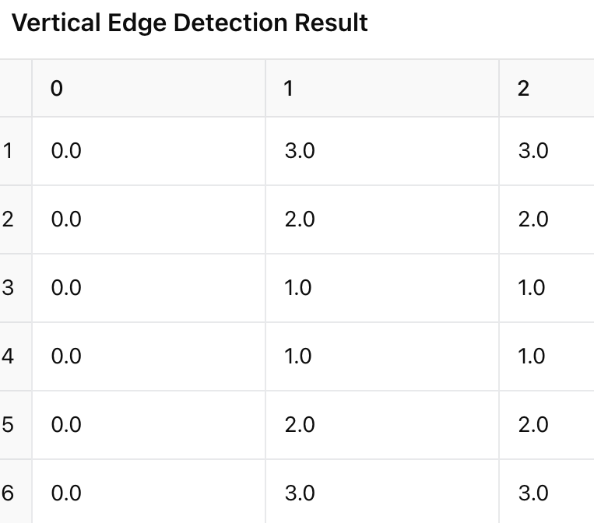
Convolution Results
Notes:
Vertical Edge Detection:
Strong values on the left and right edges of the cross, meaning the filter successfully detected vertical edges.
Horizontal Edge Detection:
High values at the top and bottom of the cross, detecting horizontal edges.
Sharpened Image:
Enhanced contrast around edges, making details clearer.

